Slide 1



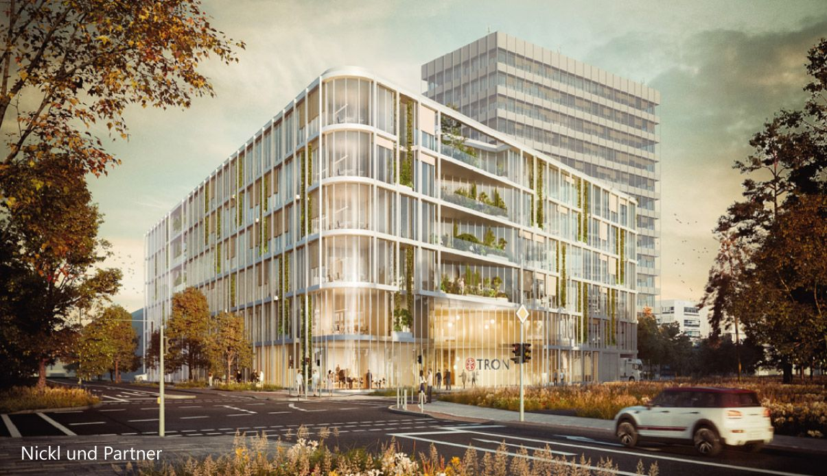
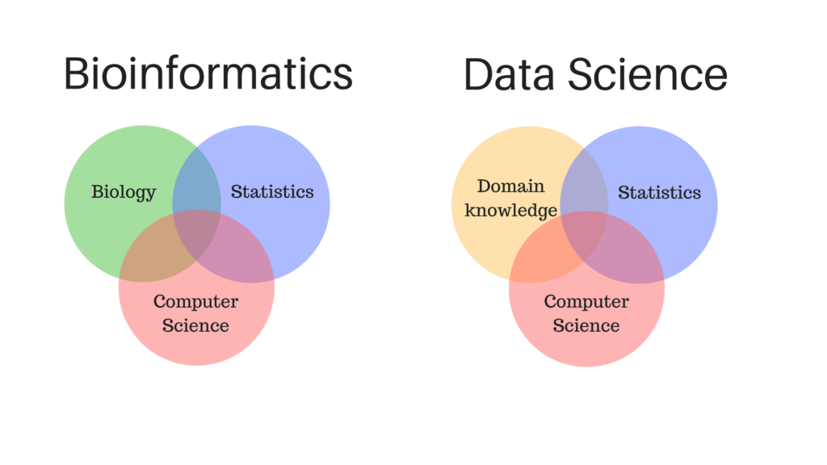
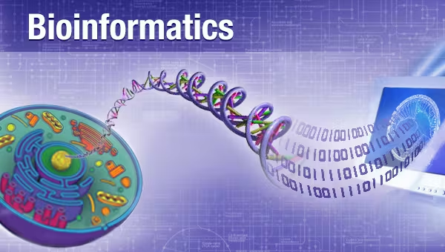
Introduction to Bioinformatics
Study program: Bioprocess Engineering
Elective Module (Wahlpflichtmodul)
9th October to 13th October
Responsible: Prof. Dr. Axel Blokesch, blokesch@fb2.fra-uas.de
by Pablo Riesgo-Ferreiro, TRON gGmbH
pablo.riesgoferreiro@tron-mainz.de
Day 2 - Session 1

Slide 2
Outline of session
Computational genomics pipelines
Variant annotation
Online biological databases
Genome browsers
Single cell approaches
Proteomics

Slide 3
Computational genomics pipelines

Slide 4
Computational genomics pipelines - variant annotation
Given a set of aligned reads (allowing mismatches!) we aim to identify
Challenges:
bla
bla
Applications:
bla
Figure 1 from https://doi.org/10.3390/app11020819 (Pös, 2021)
Standard input: VCF Standard output: VCF

Slide 5
Online biological databases

Slide 6
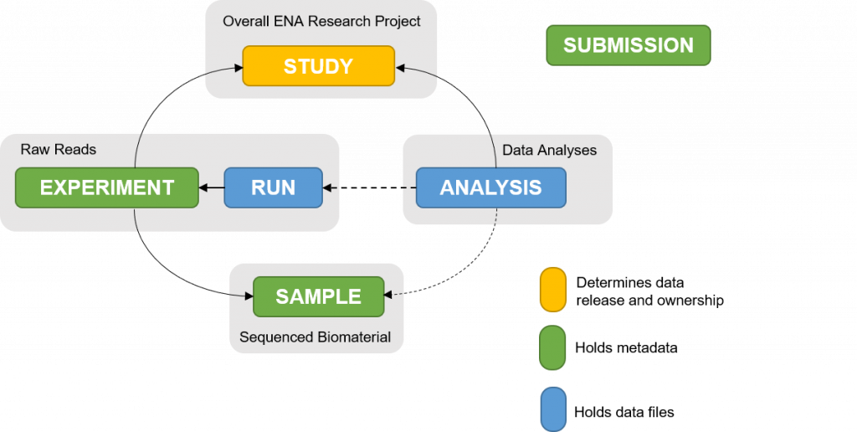
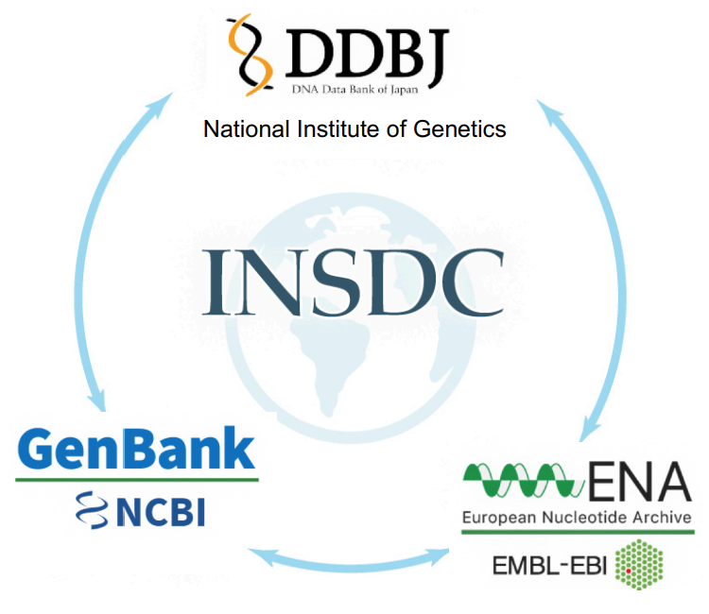
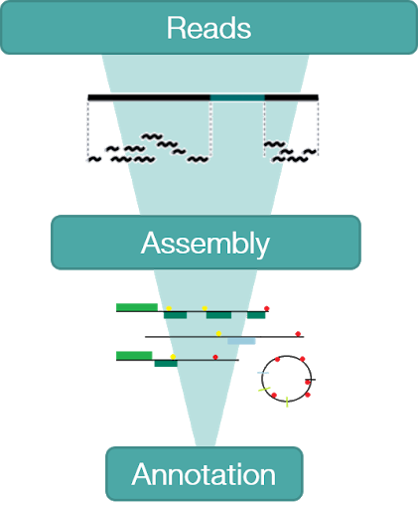
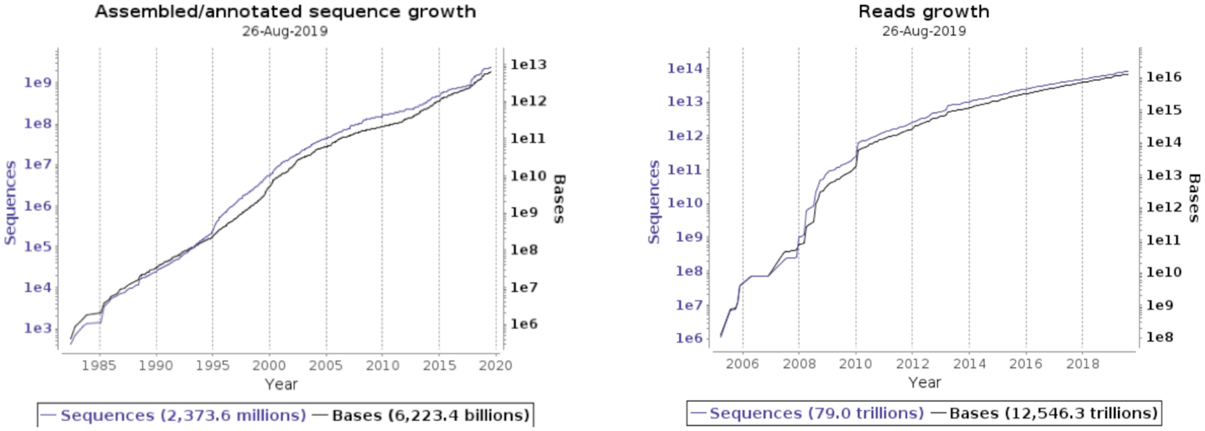
Online biological databases
Databases are synchronized daily
ENA metadata model
ENA‘s three tiered data architecture
(Amid, 2020)
https://www.ebi.ac.uk/training/online/courses/ena-quick-tour/what-is-ena/what-can-i-do-with-resource-name/

Slide 7
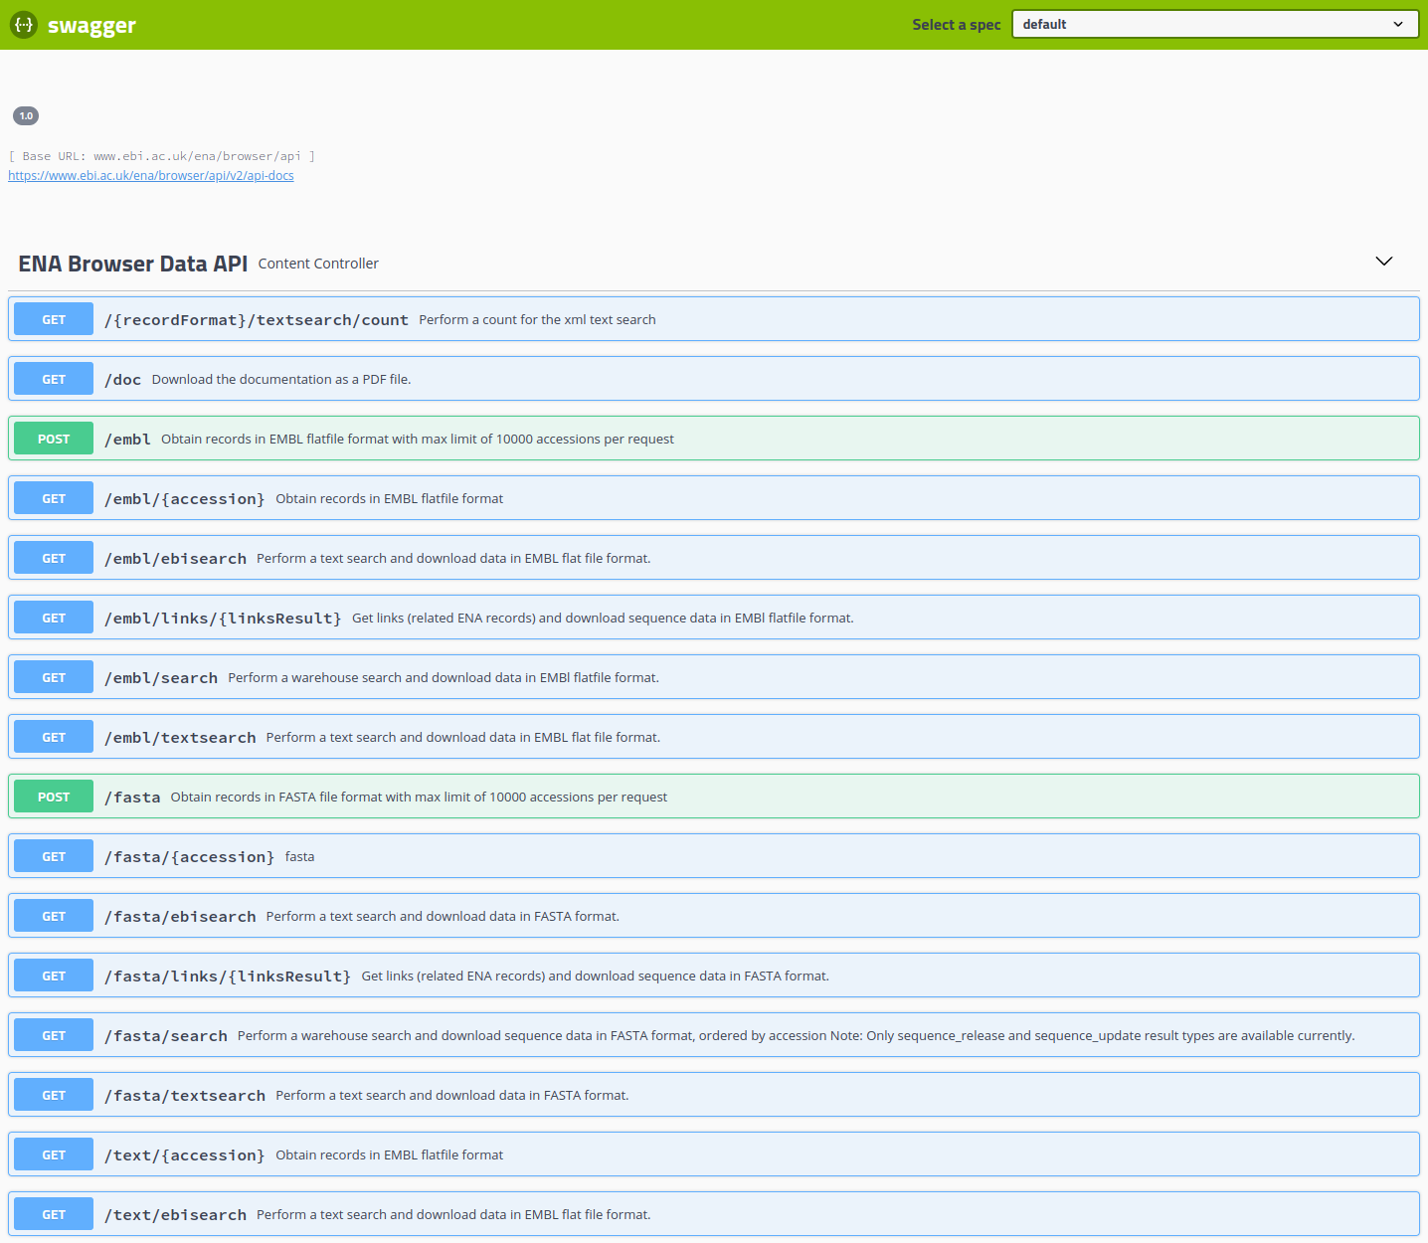
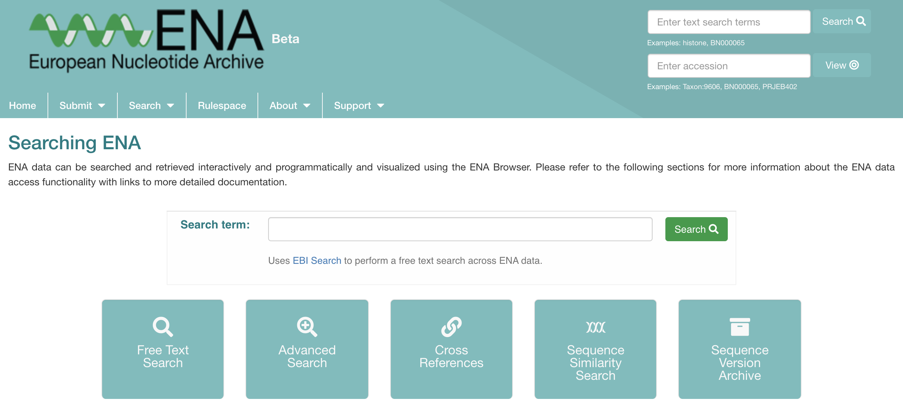
Navigating ENA data and REST APIs
Web browser https://www.ebi.ac.uk/ena/browser/home
API: Application Programming Interface
REST: Representational State Transfer
REST is a software architecture, the one used by the World Wide Web, and it can be summarised in stateless systems
An API is used to programmatically access a resource
REST APIs are the current state of the art to access online databases programmatically
REST API for programmatic access https://www.ebi.ac.uk/ena/portal/api/swagger-ui/index.html https://www.ebi.ac.uk/ena/browser/api/swagger-ui.html
https://ena-docs.readthedocs.io/en/latest/retrieval/programmatic-access.html
Practical use case 1

Slide 8
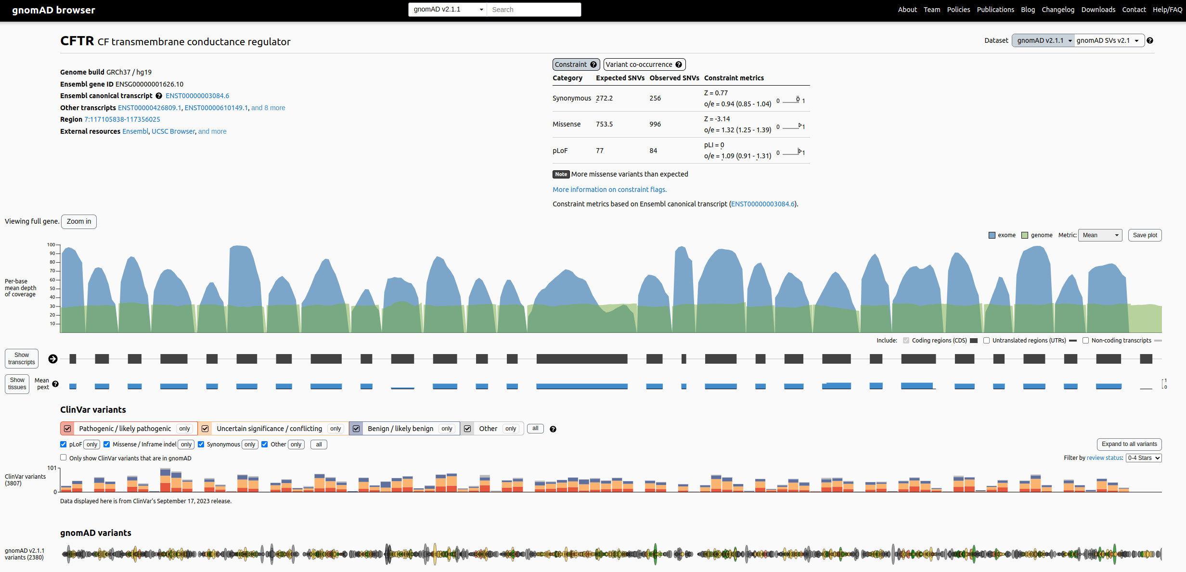
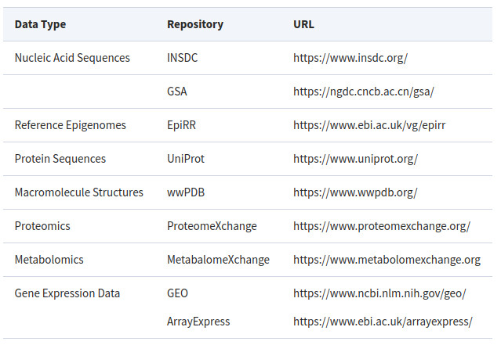
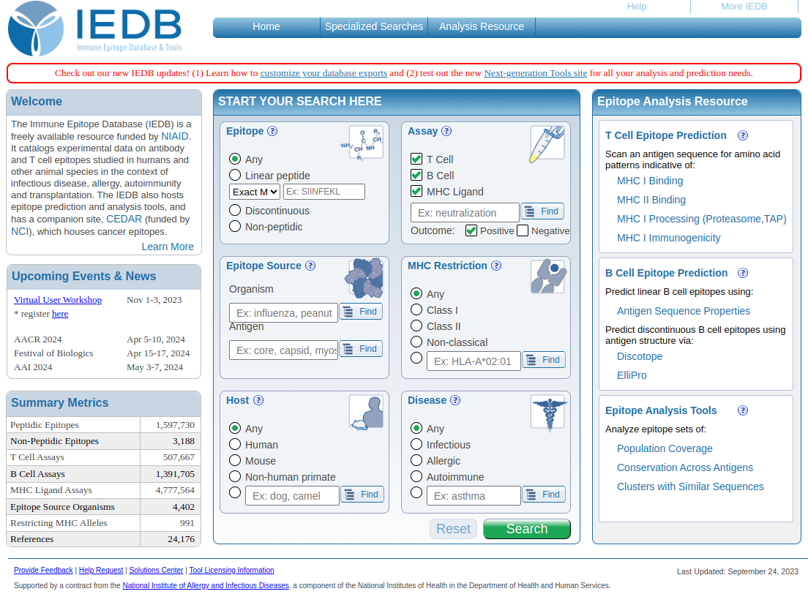
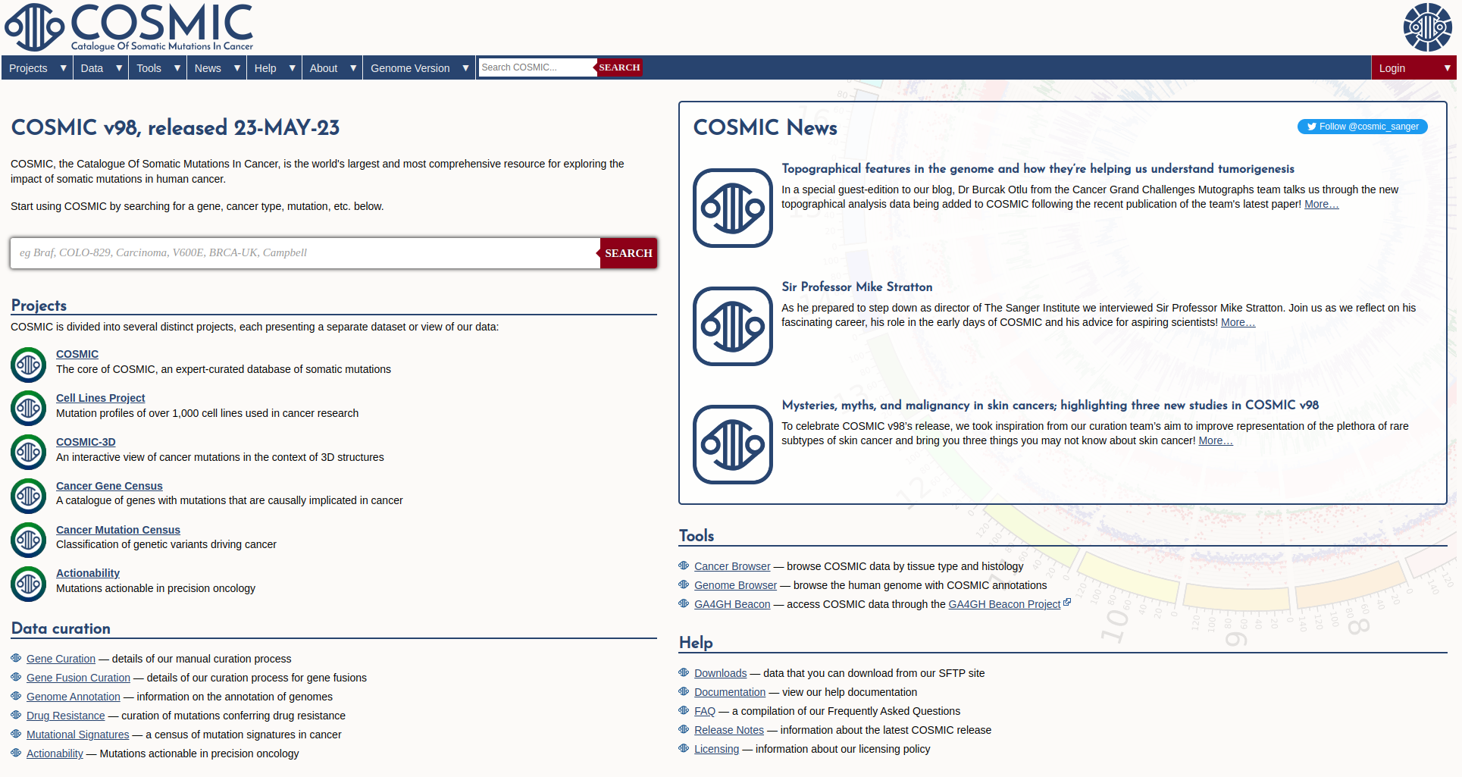
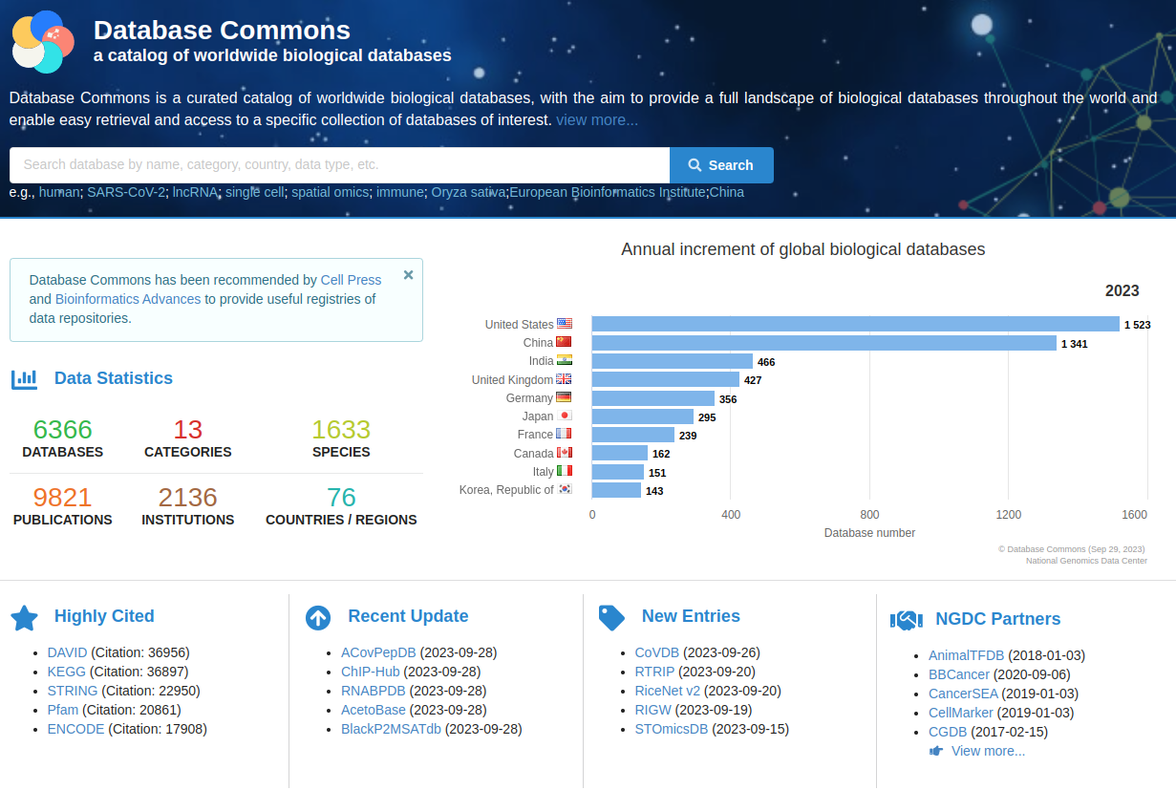
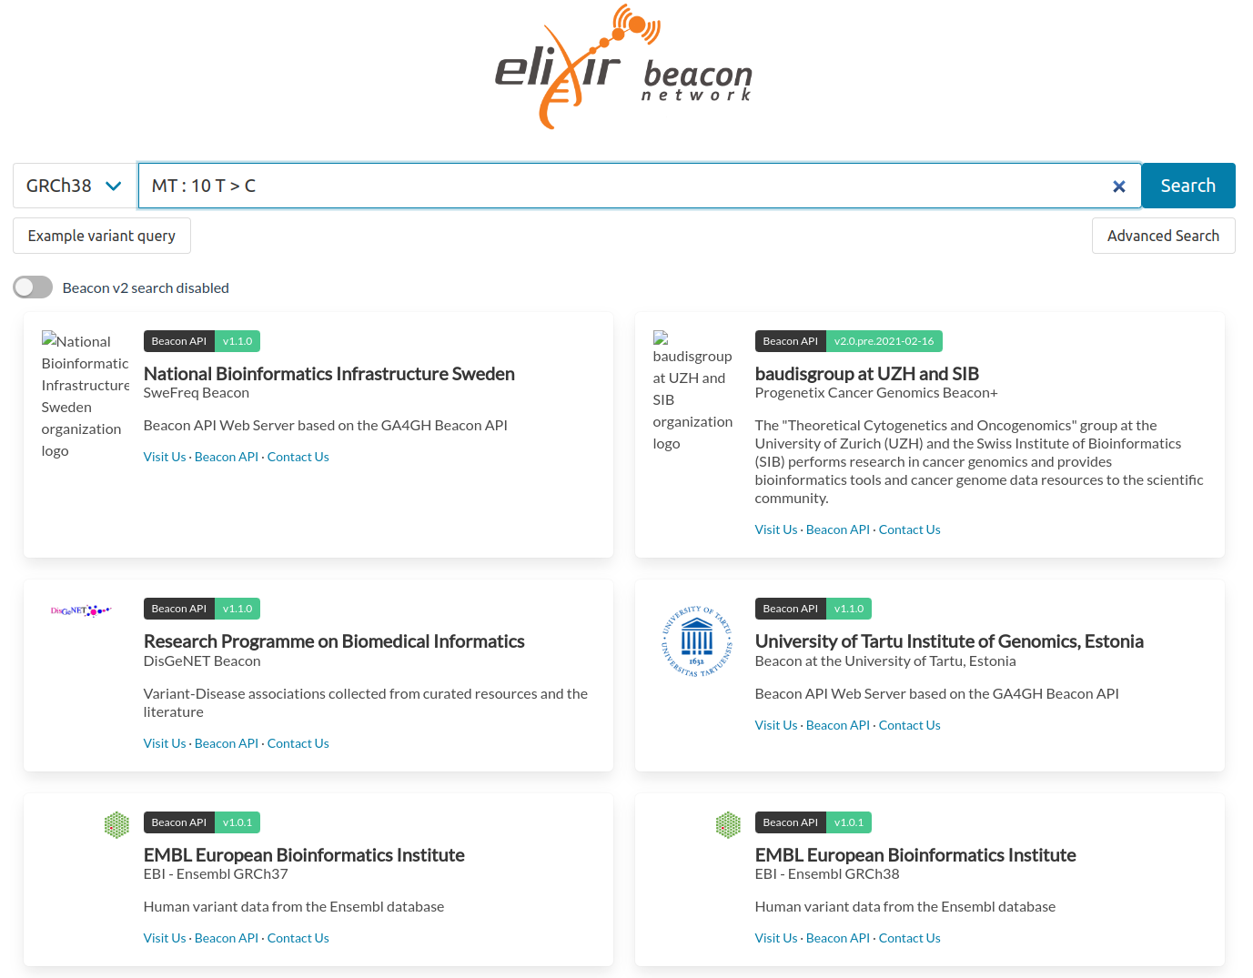
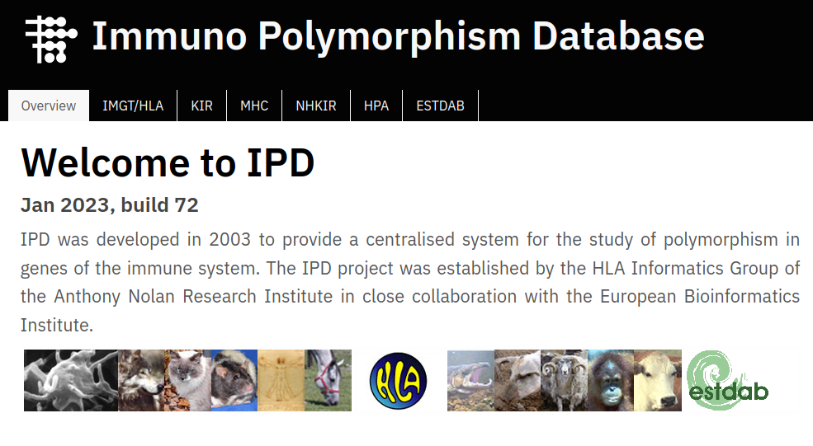
More and more biological databases
https://gnomad.broadinstitute.org/ (Karczewski, 2020)
https://academic.oup.com/bioinformaticsadvances/pages/instructions-to-authors
https://www.iedb.org/ (Vita, 2019)
https://cancer.sanger.ac.uk/cosmic (Tate, 2019)
https://ngdc.cncb.ac.cn/databasecommons/ (Ma, 2022)
https://beacon-network.elixir-europe.org/ (Rueda, 2022)
https://www.ebi.ac.uk/ipd/ (Robinson, 2013)

Slide 9
Genome browsers

Slide 10
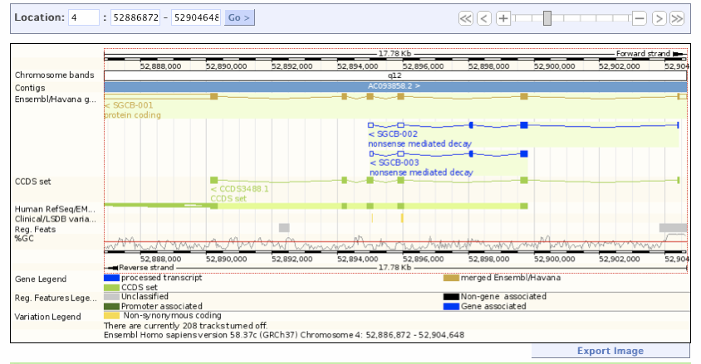
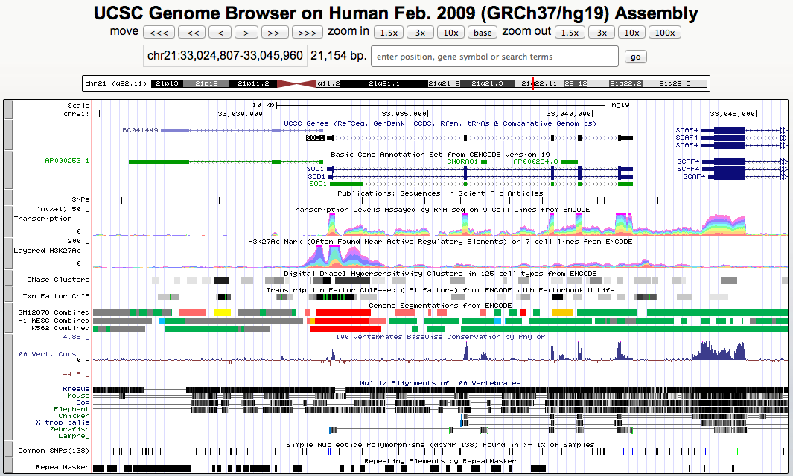


Online genome browsers

Slide 12
FAIR sharing
https://fairsharing.org/

